Slide 1
Things around the home
Can I eat / Can I drink…
QUIZ
Let’s Begin…

Slide 2
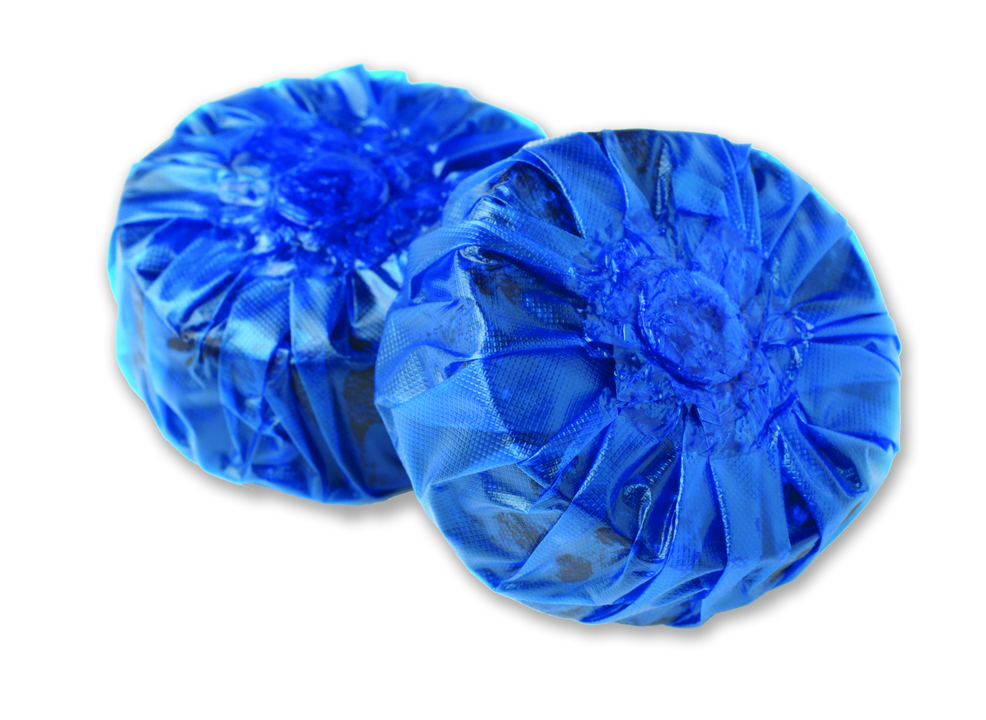


Can I eat…
Toilet Block?
Safe
Dangerous

Slide 3
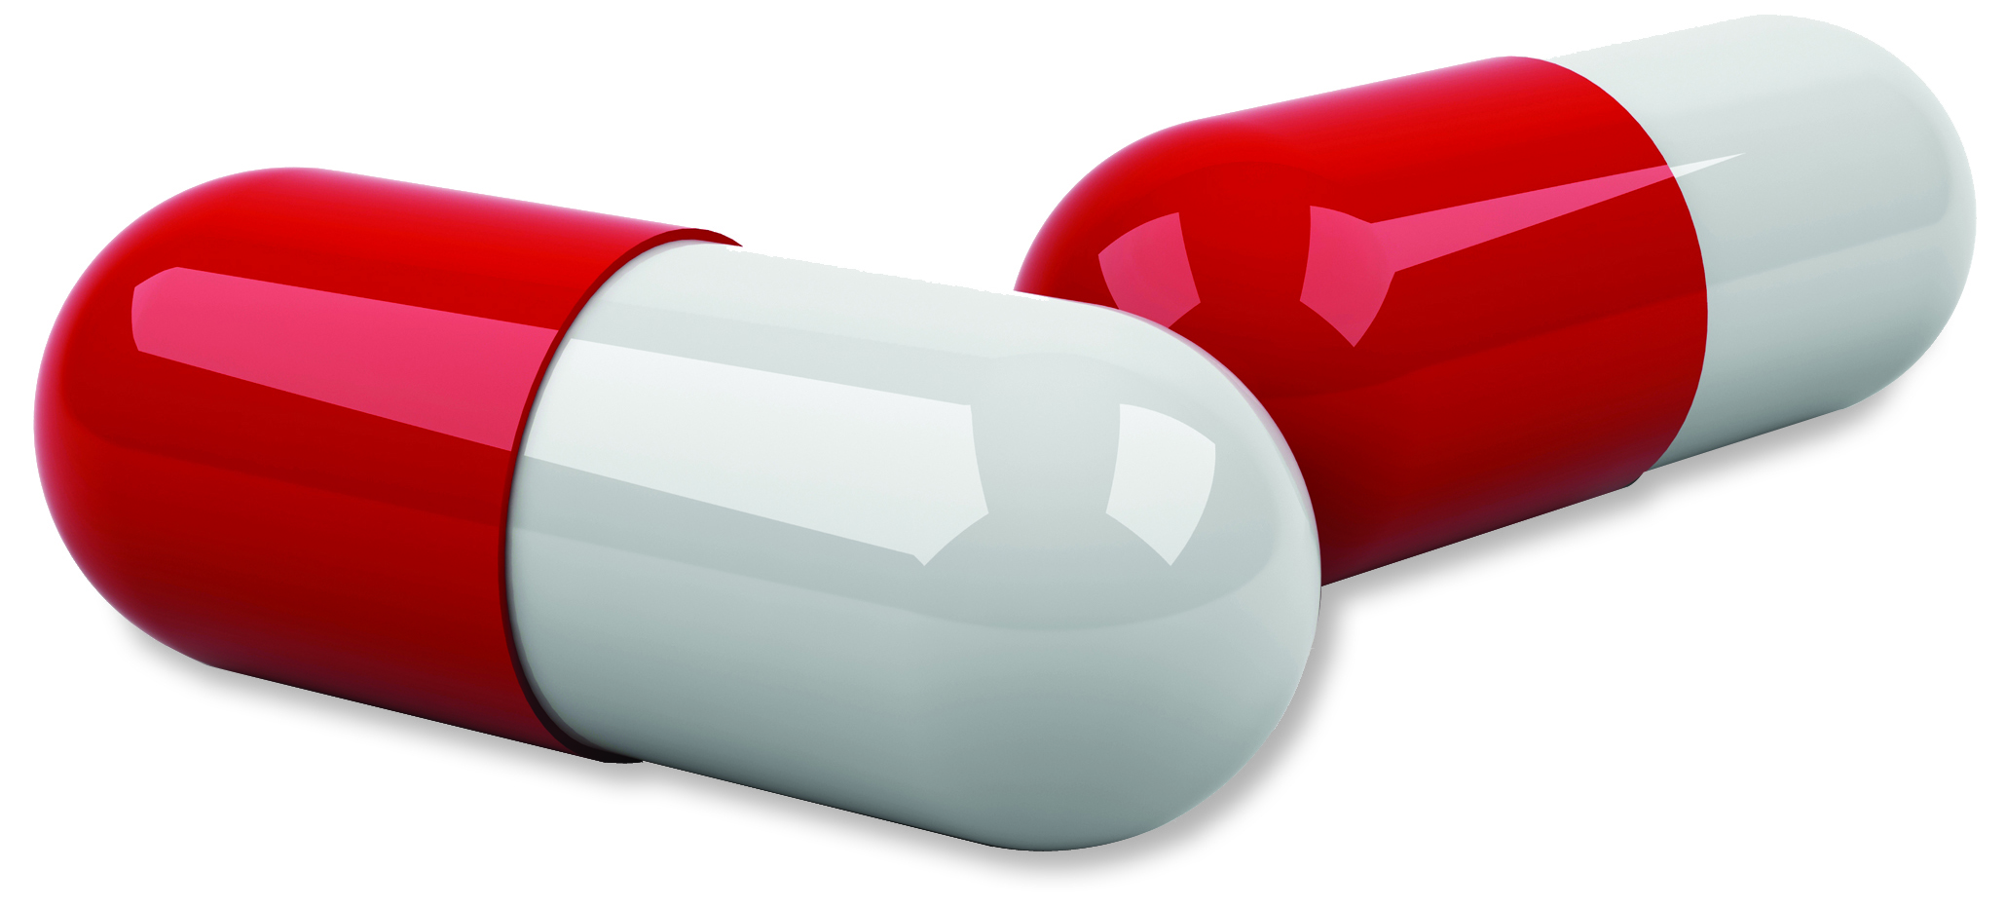
Can I eat…
Tablets?
Safe
Dangerous

Slide 4
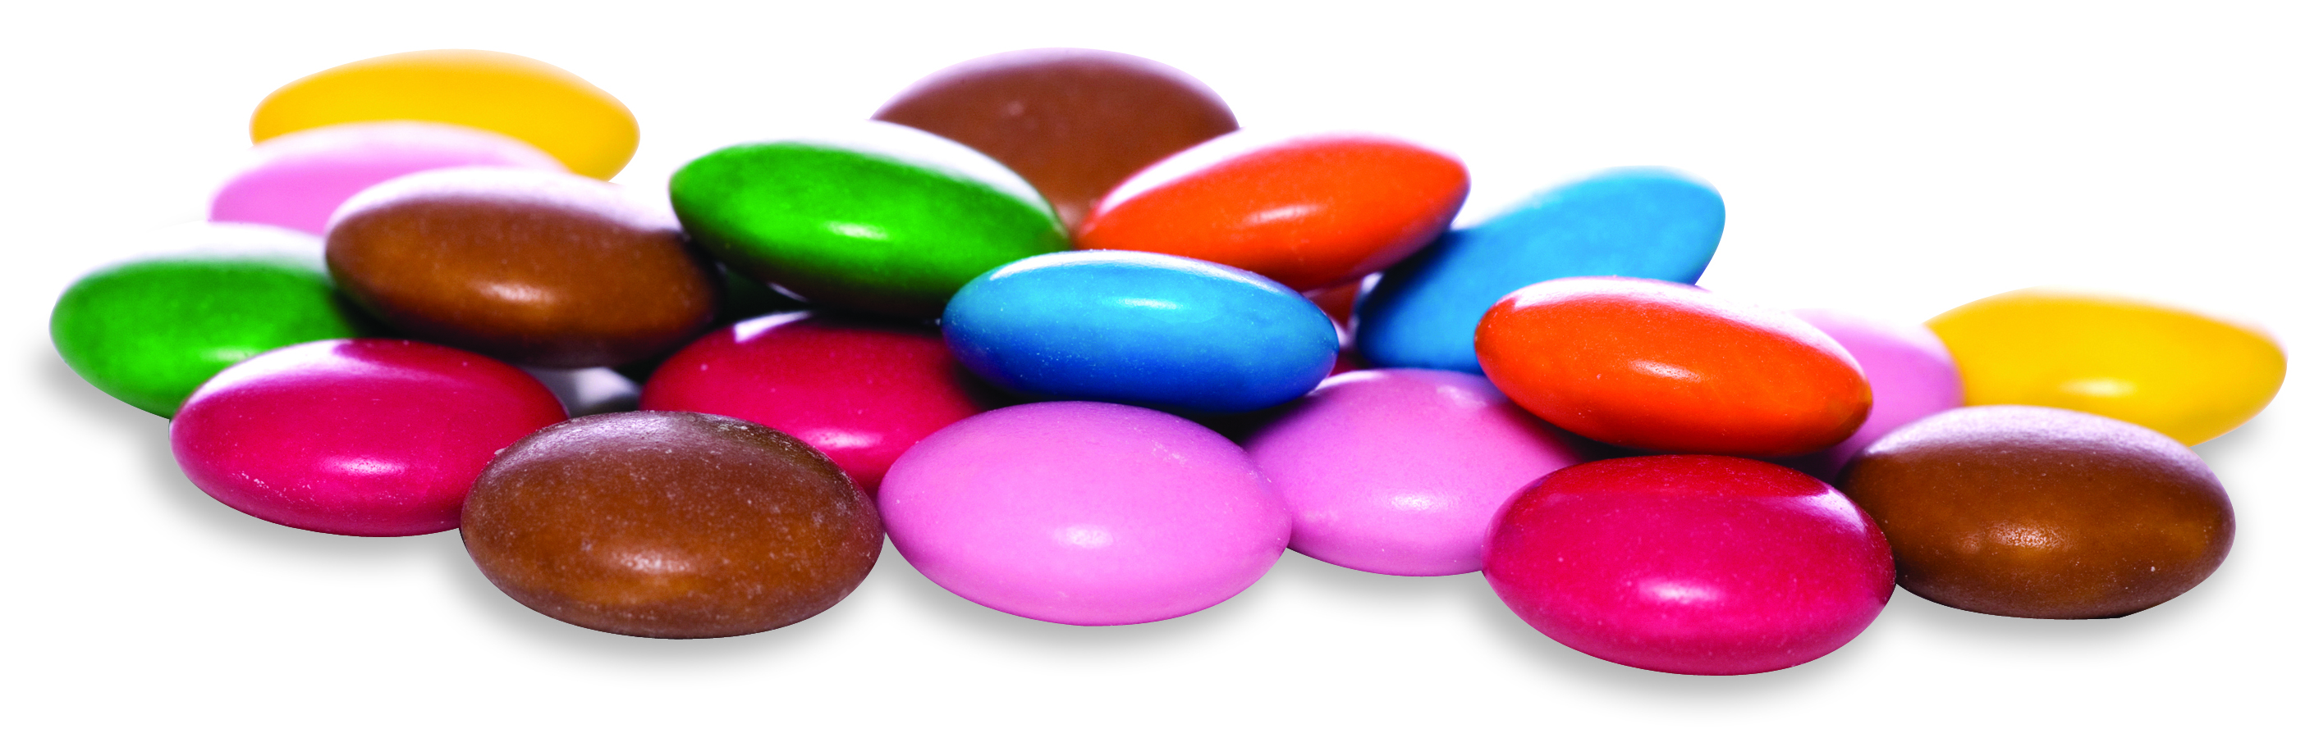
Can I eat…
Sweets?
Safe
Dangerous

Slide 5
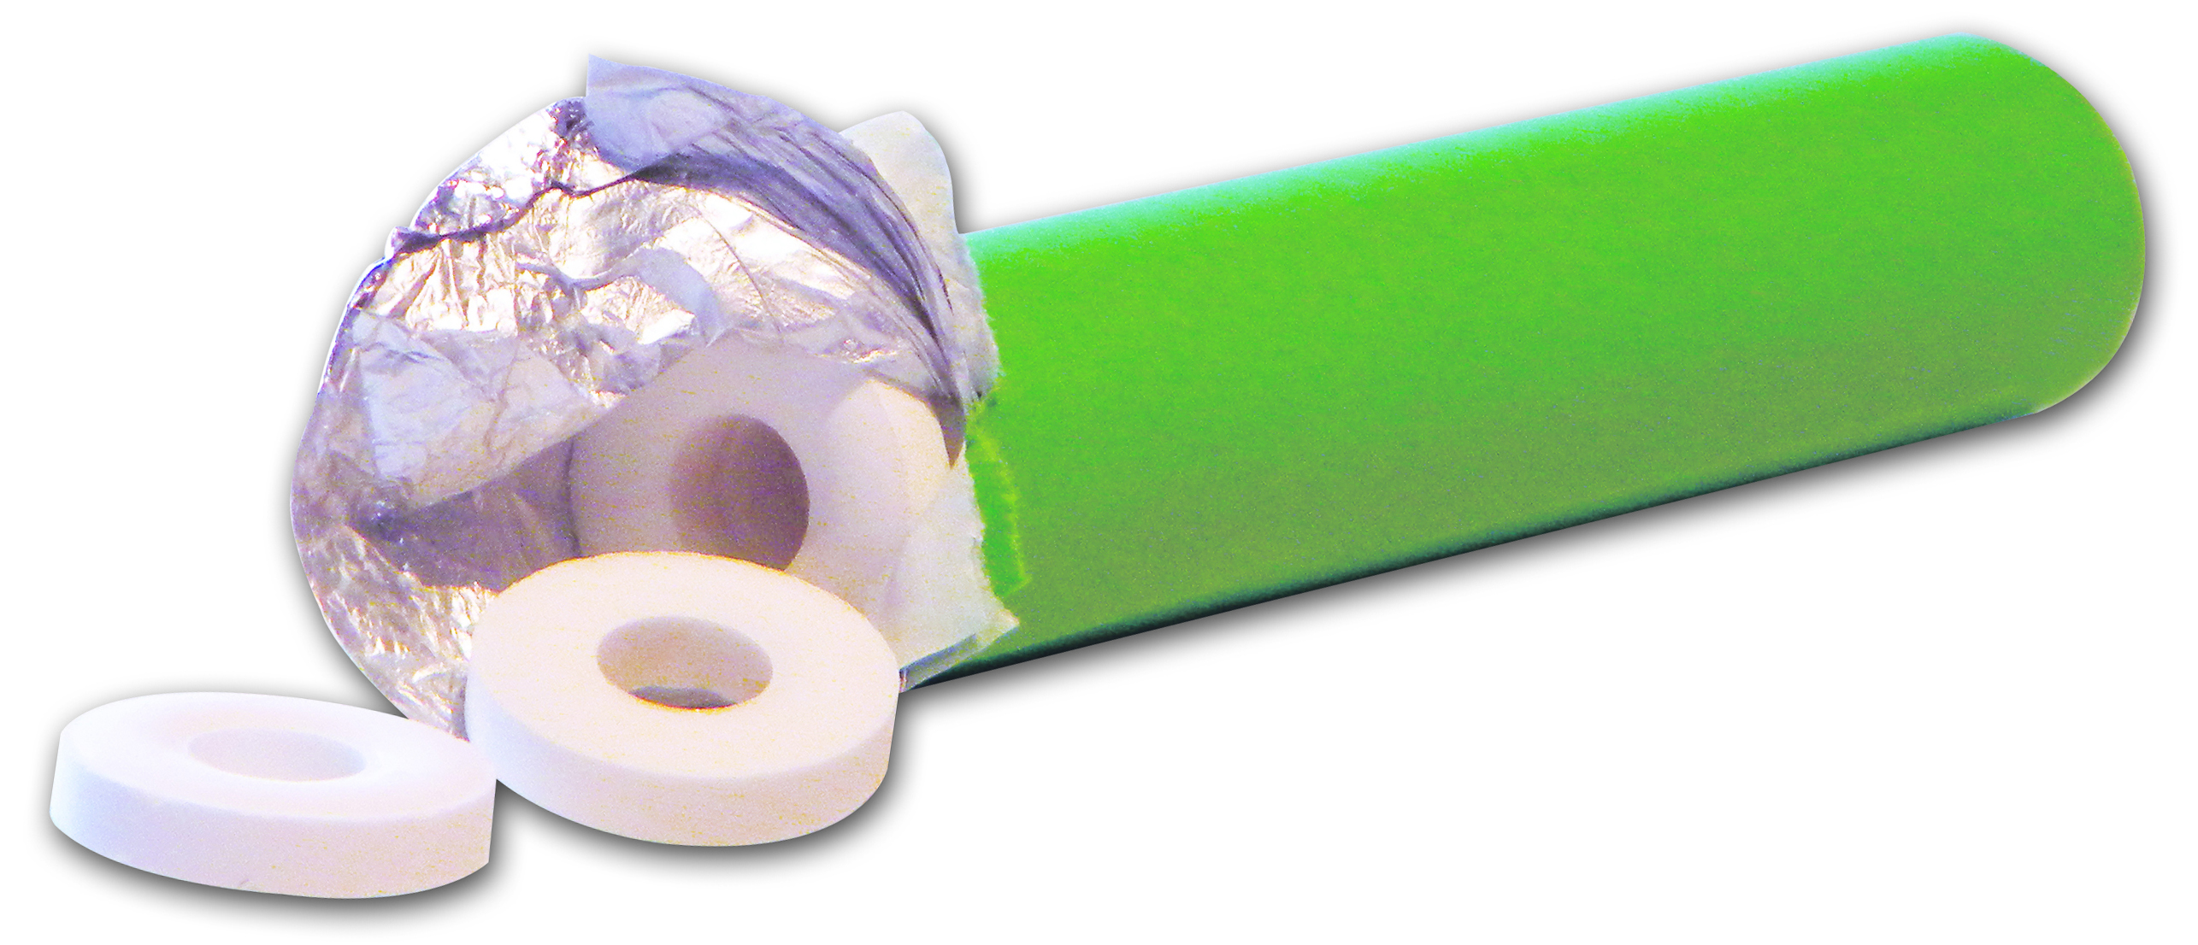
Can I eat…
Mints?
Safe
Dangerous

Slide 6
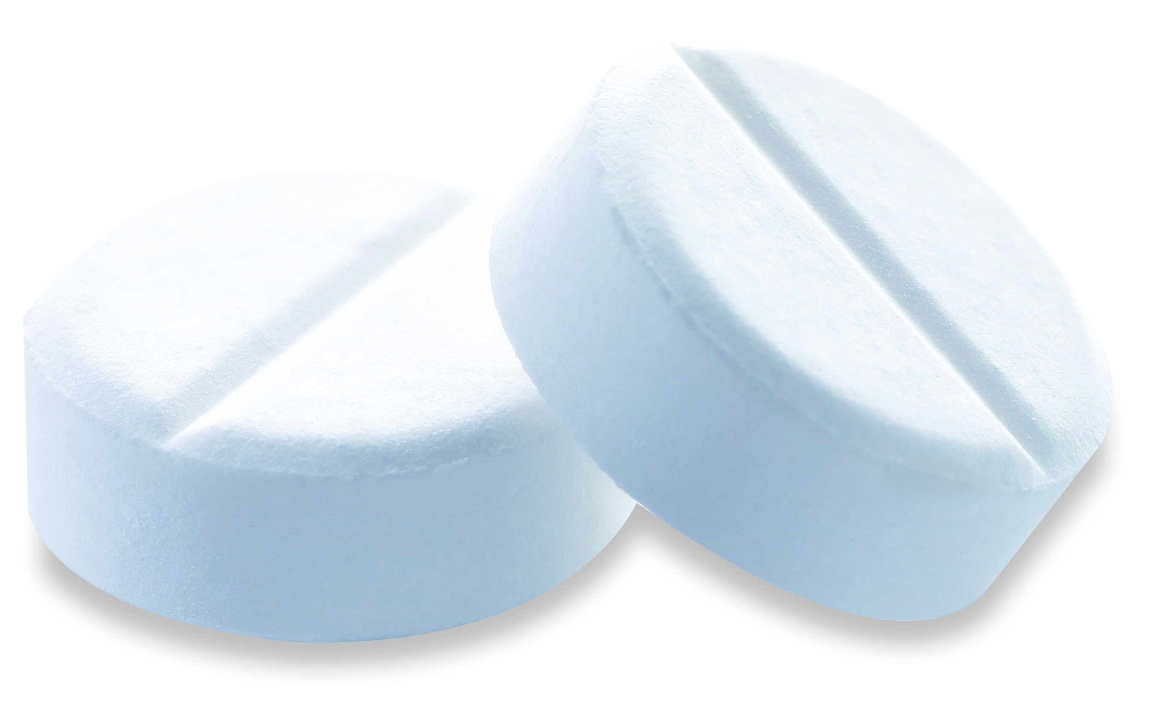
Can I eat…
Headache Tablets?
Safe
Dangerous

Slide 7
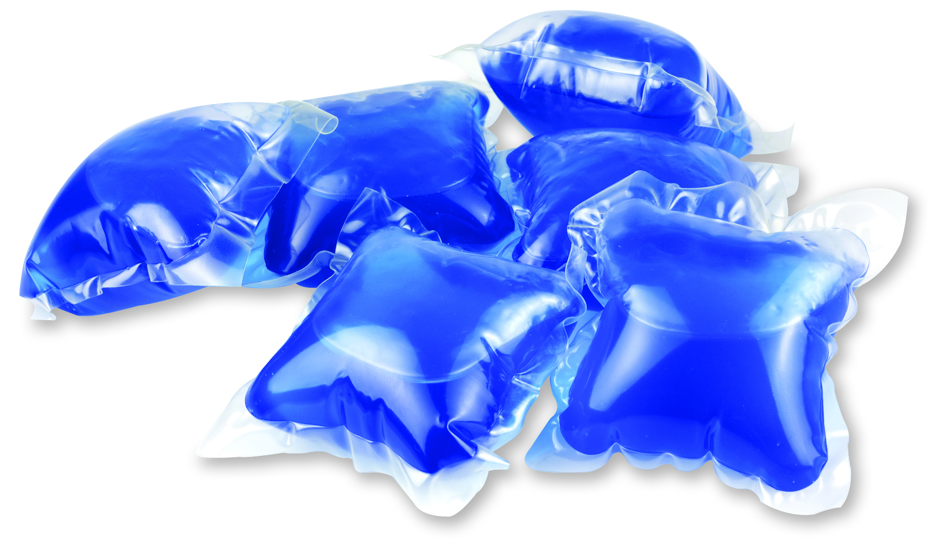
Can I eat…
Liqui-Tabs?
Safe
Dangerous

Slide 8
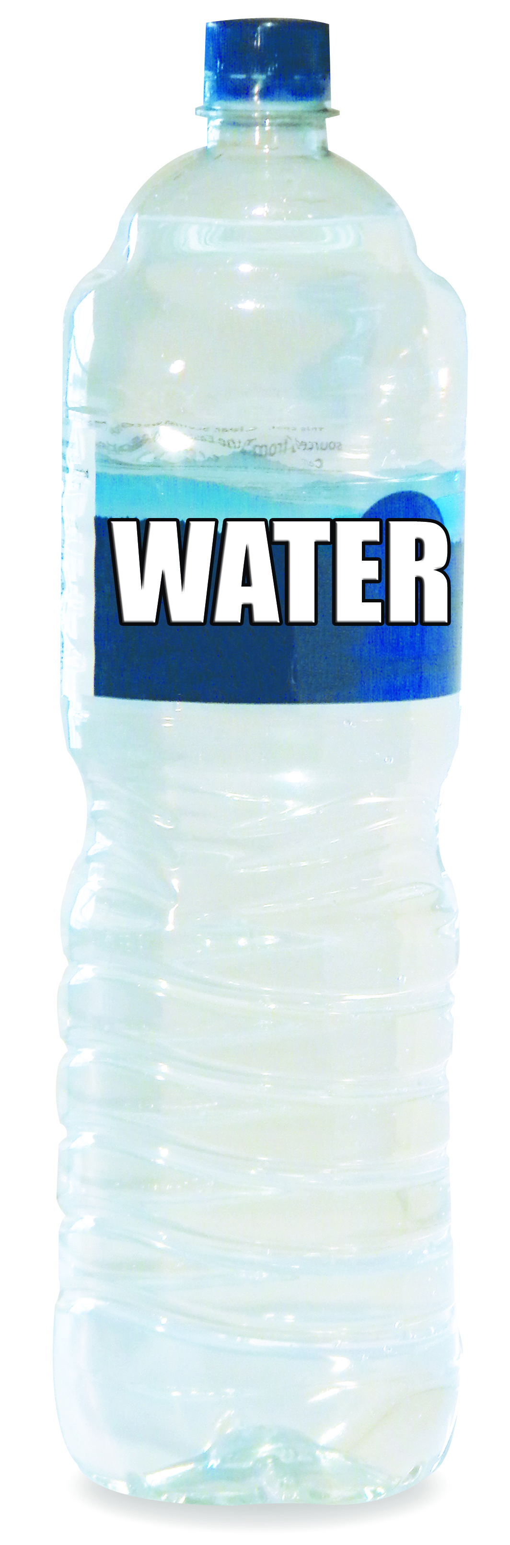
Can I drink…
Water?
Safe
Dangerous

Slide 9
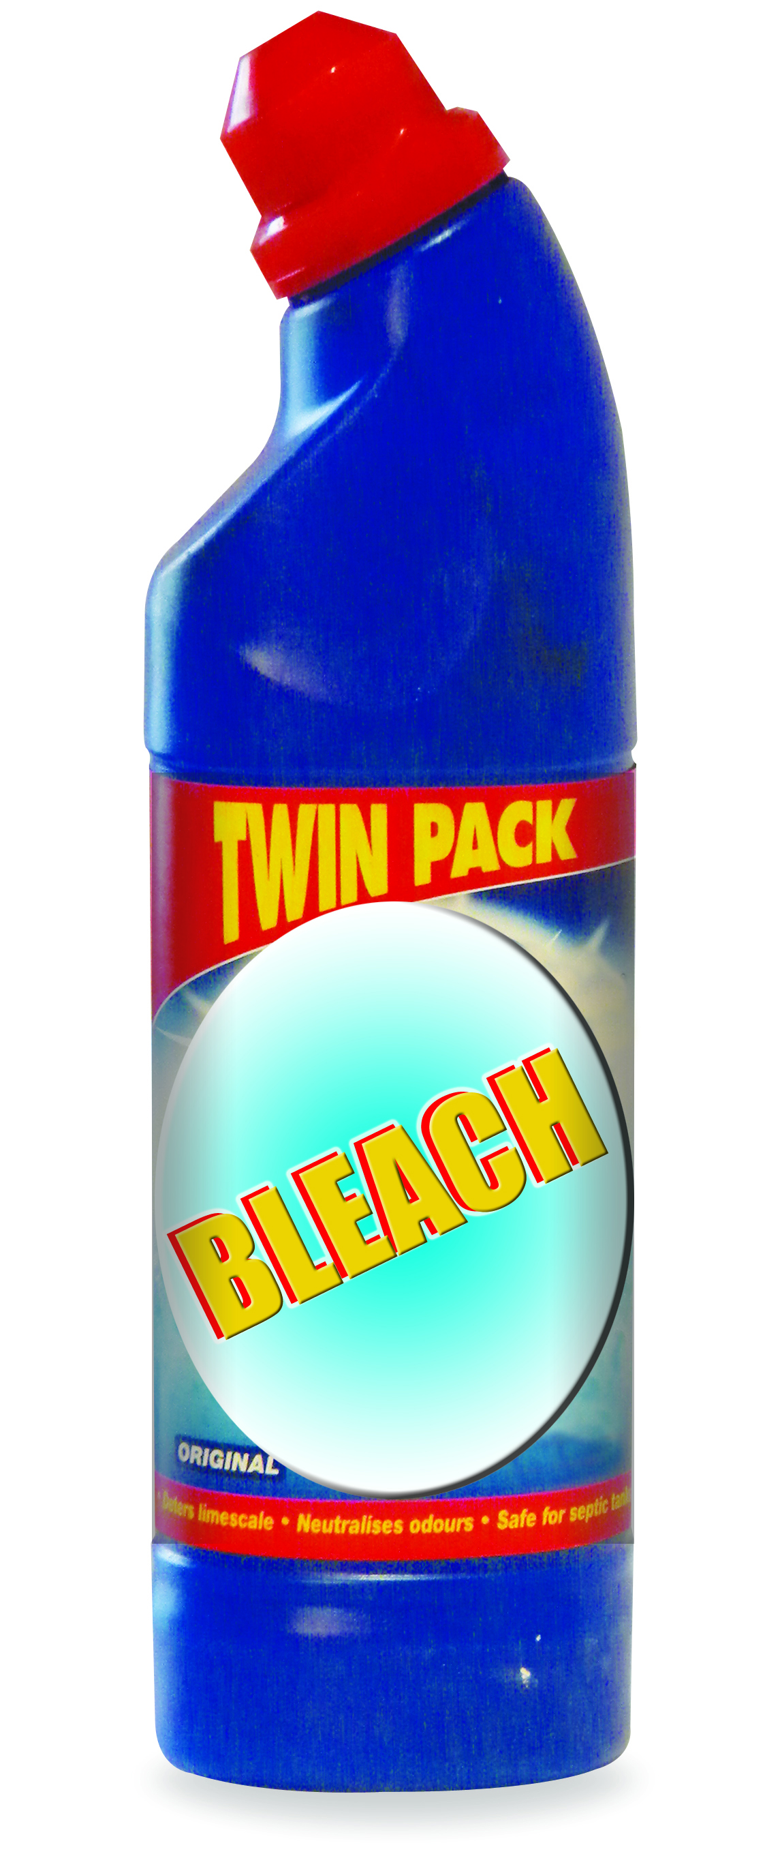
Can I drink…
Bleach?
Safe
Dangerous

Slide 10
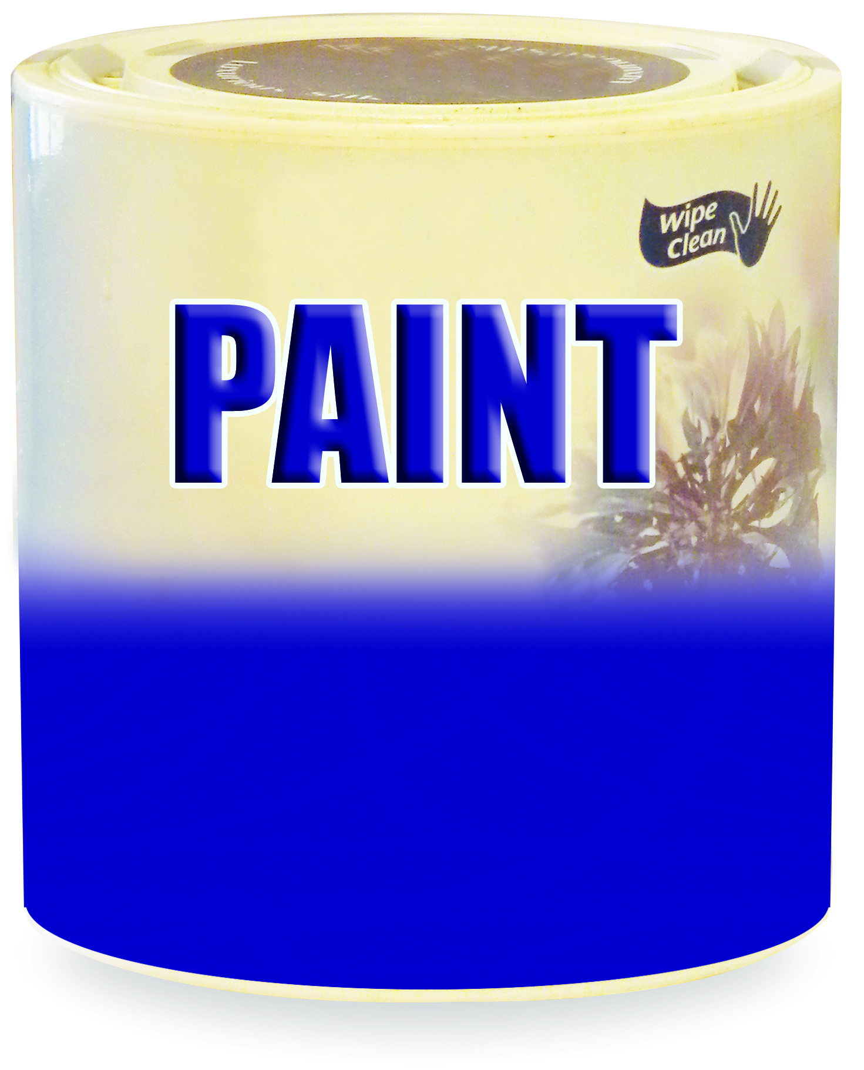
Can I drink…
Paint?
Safe
Dangerous

Slide 11
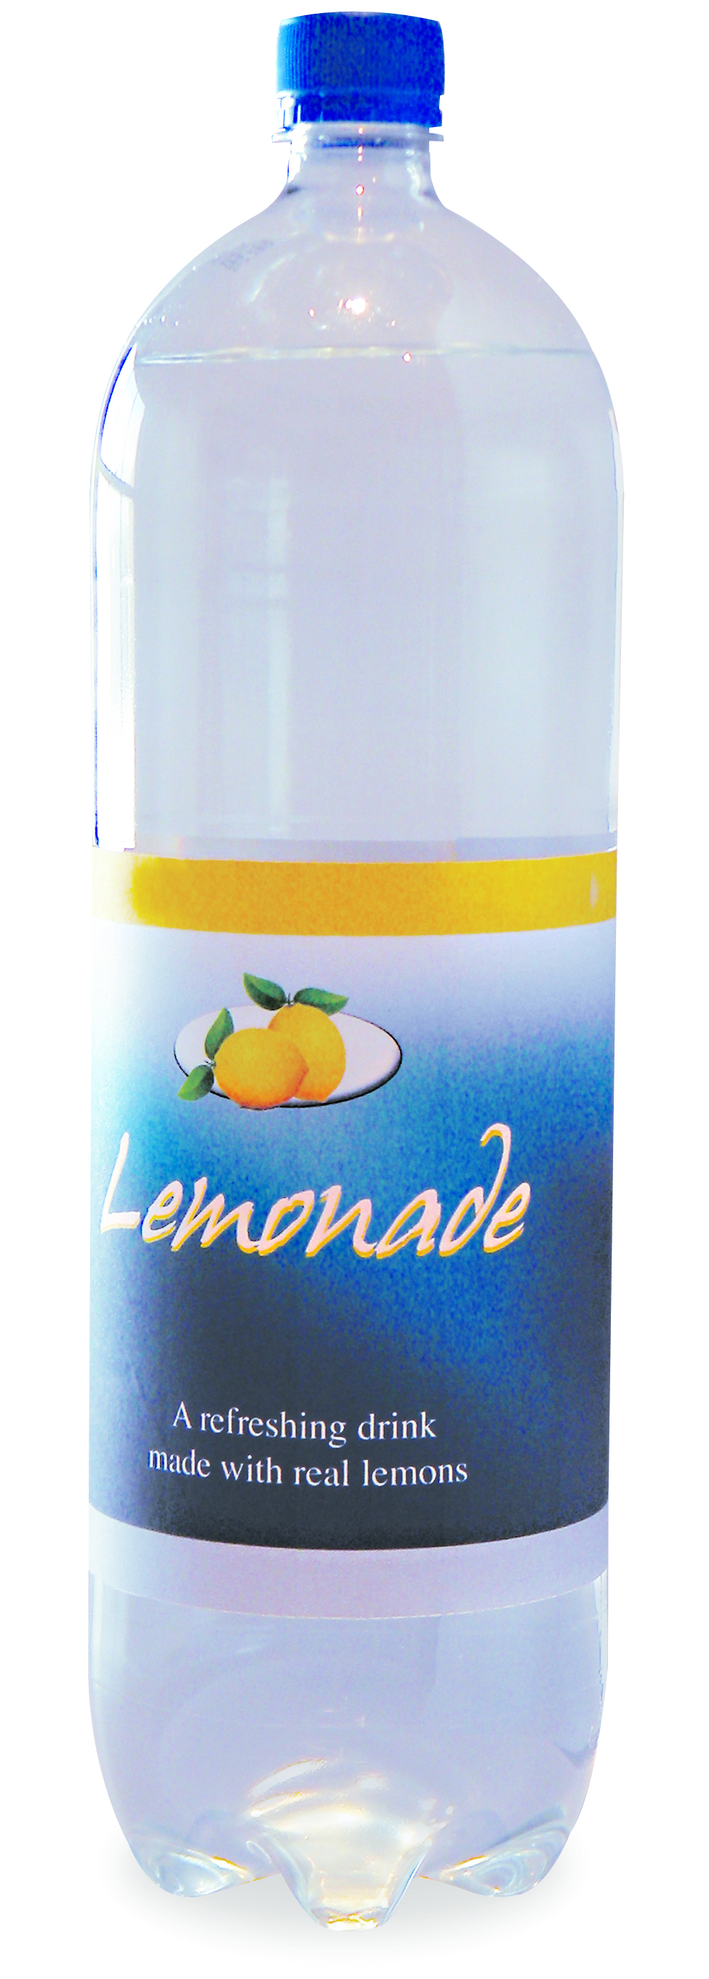
Can I drink…
Lemonade?
Safe
Dangerous

Slide 12
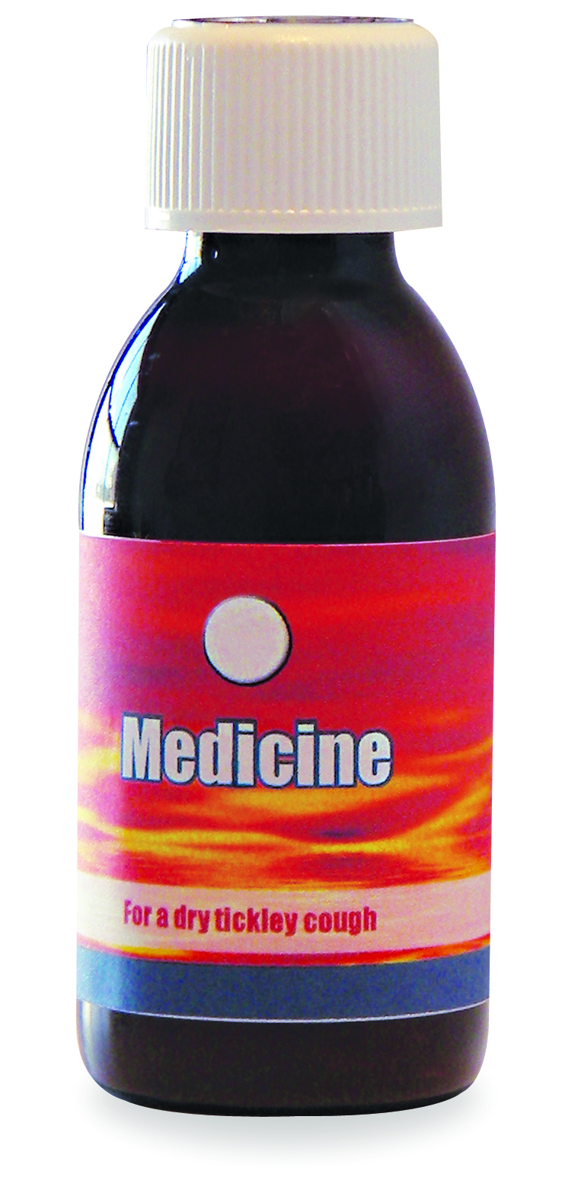
Can I drink…
Medicine?
Safe
Dangerous

Slide 13
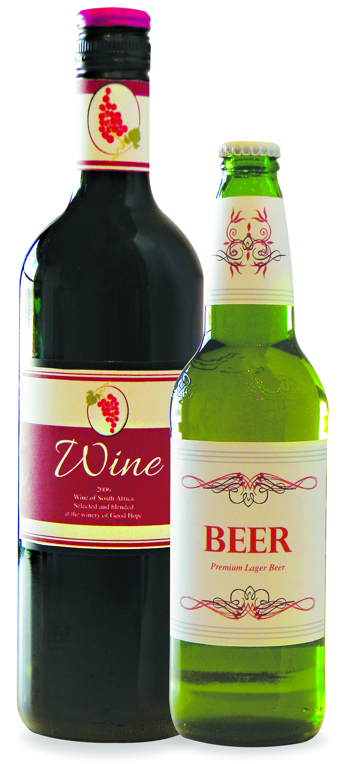
Can I drink…
Beer/Wine?
Safe
Dangerous

